Slide 1
Closing the Adaptation Gap in agriculture: Scaling Agvisely Climate Services to Build Resilient Farming Systems in Bangladesh
28/01/2026
T.S Amjath-Babu, Senior Agricultural Economist , CIMMYT

Slide 2
Scaling Track Presentation Outline
Flagship Scaling Track Process
Introduction of the innovation/package
Agvisely – farming system advisories
The scaling pathway(s) for achieving scaling ambition
Agvisely Scaling plan – Portfolio of bundles
Agvisley – increasing value proposition
Scaling bundles: Why Agvisely?
Scaling ambition -2026 and beyond
Key scaling and demand partners and evidence
Scaling strategy and challenges
Theory of change statement
Implementation GANNT chart
Bilateral Projects

Slide 3
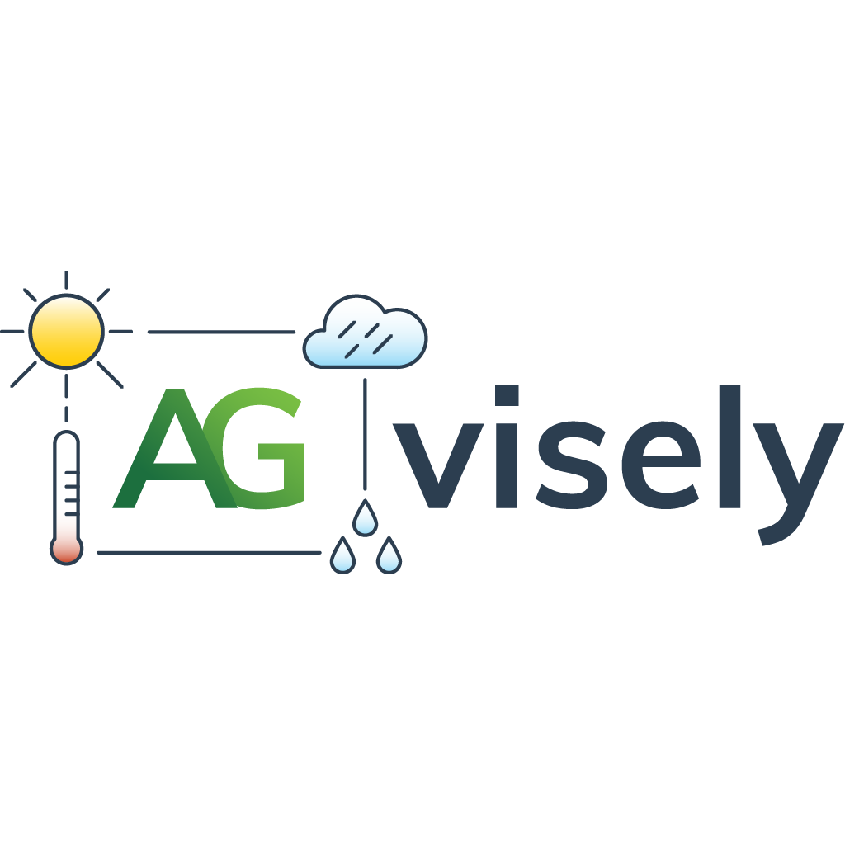
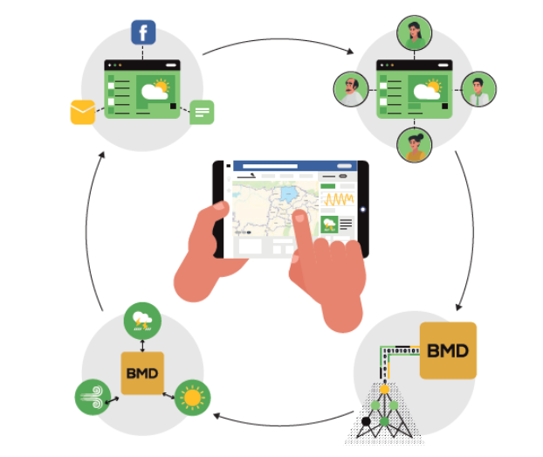
– Farming system level advisories
Commodities
* 10 crops (Aman, Boro, Aus rice, Kharif Maize, Rabi Maize, Mungbean, Lentil, Wheat, Mustard, Potato)
* Livestock: Cows, Chicken
* Aquaculture: Carps, Shrimp*
* Planned expansion to horticultural crops
Geography and users
* All upzilas (administrative unit) of Bangladesh
* Registered users: 8000+ extension officers (DAE)
Partners
* BMD, DAE, BLRI, RIMES, WorldFish.
Other Services for enhancing value proposition
Good agricultural practices (stage specific)
Integrated pest management advisory (Stage specific)
4
1
Generate
Transfer & Use
Automated processing numerical weather model forecast output
BMD/RIMES/UKMET
Mobile app,
website, SMS,
social media
2
Analyze
3
Automated detection of biological thresholds being exceeded in next 5 days for forecasted temperature, rainfall or Temperature-Humidity Index (crops, livestock, aquaculture) . Integrated crop calendar.
Translate
Automated translation of detected thresholds to advisory notifications based on growth stage (crop, livestock, aquaculture). Stage specific GAPs, IPM advisory

Slide 4
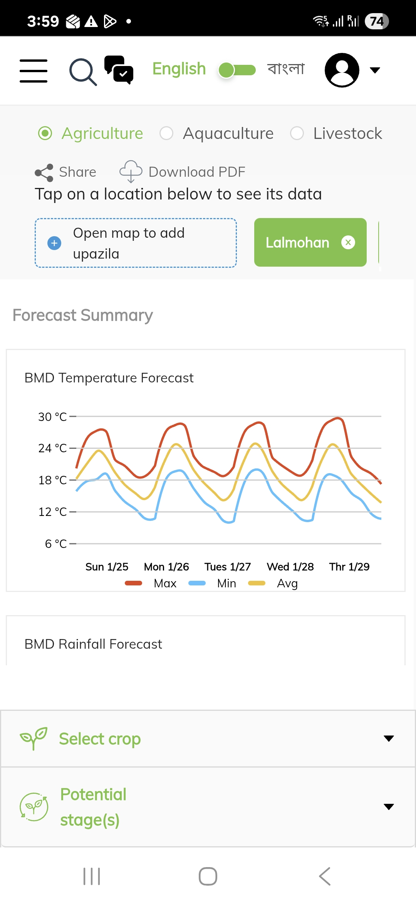
Agvisely scaling plan
AIS and DAE
CIMMYT– Bilateral
IRRI – Bilateral
Lead farmers’ network
Extension bundle
WF –CGIAR Climate Action
IRRI/WF
Agvisely institutionalization with microfinance partner
Agvisely API integration ONE Fish app
WF
CIMMYT
Finance bundle
Agvisely API integration with Private sector Fintech partner
CIMMYT
Agvisely API integration with Govt. partner(BARC) app
CIMMYT
Agitech bundle
Agvisely API integration with Private sector Agritech partner

Slide 5
Agvisely scaling plan
Agvisely API integration with Insurance provider
Agvisely API integration with Insuretech partner (livestock)
Insurance bundle
IRRI
Service provision bundle
Agvisely training for harvesting machinery operators
IRRI/CIMMYT/WF
NGO bundle
Agvisely training to climate leads of NGOs for institutionalization

Slide 6
Agvisely scaling plan by increasing value proposition
New crops
Agvisely integration of wheat disease prediction
CIMMYT - Bilateral
Disease forecasting bundle
Fertilizer use advisory
CIMMYT - Bilateral
Fertilizer bundle
CIMMYT – Bilateral (Aflatoxin)
Food safety bundle
Quality of forecast (AI)
CIMMYT - Bilateral
AI Integration (Text to voice)
AI bundle

Slide 7
Why adopt Agvisely?
Extension bundle
Institutional mandate
Lead farmers’ social capital
Finance bundle
Reduction in loan defaults /delays in payments by customers
Food safety bundle
Enhanced value proposition offering new scaling paths
Agitech bundle
Enhanced value proposition
Fertilizer bundle
Alignment with Govt. policy and carbon markets
Insurance bundle
Cost efficiency in access to advisories and claims settlement
Disease forecasting bundle
AI bundle
Inclusive high value service
Enhanced value proposition of Agvisely tool
Enhanced value proposition offering climate related project and microfinance schemes.
NGO bundle
Service provision bundle
Enhanced business opportunities and cost reduction possibilities

Slide 8
Targets - 2026
650,000
100,000
Extension bundle
20,000
50,000
25,000
10,000
Finance bundle
10,000
Agitech bundle
100,000
Expected Bilateral funding
Insurance bundle
Disease forecasting bundle
1,000
Service provision bundle
300K
Fertilizer bundle
Reach : 1 mllion farmers in 2026
NGO bundle
Food safety bundle
Reach :3.5 mllion farmers by 2028
AI bundle

Slide 9
Scaling and Demand Partners
Bundle
partner
Evidence
Evidence
Rice transplanter SPs
Bundle
partner
Extension bundle
Circular under process
Combine and reaper service providers
Demand Surveys
DAE, AIS
Service provision bundle
Finance bundle
PKSF, iFarmer
Formal requests
Food safety bundle
BAU
Bilateral investment
Agitech bundle
Genius Farms Ltd. WF, Khamari
Formal request
Insurance bundle
Pranisheba, Green Delta
Formal request
Fertilizer bundle
DAE
Govt. policy
Disease forecasting bundle
DAE
Existing collaboration
Multiple partners
Demand Surveys
AI bundle
IRRI, CIMMYT and WF partner NGOs
Demand Surveys
NGO bundle
Note: Lead farmers , BAU and MSPs are demand partners

Slide 10
Partners
Bundle
partner
Process
Rice transplanter SPs
Bundle
partner
process
Extension bundle
Institutionalization and Lead farmer as Digital service providers
Combine and reaper service providers
Training and business creation
DAE, AIS
Service provision bundle
Finance bundle
PKSF, iFarmer
Institutionalization, API integration
Food safety bundle
BAU
Agvisely integration
Agitech bundle
Genius Farms Ltd. WF, BARC
API integration
Insurance bundle
Pranisheba, Green Delta
API integration, training
Fertilizer bundle
DAE
Training
Disease forecasting bundle
DAE
Institutionalization
AI bundle
Multiple partners
AI - Agvisely hotline
IRRI, CIMMYT and WF partner NGOs
Training and Institutionalization
NGO bundle

Slide 11
Scaling strategy and challenges
Challenges
Increasing direct access for farmers to the Agvisely advisories . Farmers doesn’t have smart phones or data packages.
AI text to voice for dynamic content and creating Agvisely voice assistant
Scaling as bundled services Agvisely advisories are getting embedded in:
Insurance products -
Finance platforms -
Mechanization services -
NGO programs
Extension delivery channels
Institutional anchoring
Institutionalization of the Agvisely services, especially in Govt. and non-govt organizations,
Evidence-driven expansion
Performance data feeds back into bundle refinement
Evidence supports bilateral investment and policy uptake
Increasing quality of forecasts and hence advisories – Investment required
Use of sensors for water temperature is new

Slide 12
Scaling Pathway(s)
Theory of change statement
By automating the translation of weather forecast and biological thresholds into stage-specific advisories as well as providing stage specific good agricultural/livestock/aquacultural practices and integrated pest/disease management advisories and bundling them with finance, insurance, agri-tech, mechanization, and extension service intermediaries as well as ensuring direct access through a voice assistant, Agvisely enables millions of Bangladeshi farmers to take timely action, reduce climate and pests/disease risks, and sustainably increase productivity and income at scale.

Slide 13
Implementation Gannt Chart

Slide 14
Bilateral projects and S4I additionality
Bilateral description
S4I additionality
S4I catalyzes the different scaling pathways that were not otherwise focused.
CIMMYT – Aurora Project (upcoming)
Mechanization project
IRRI – Climate Smart Agriculture (DAE)
WF - Value added fish and fishery project (upcoming)
Sustainable animal and aquatic food (SAAF)

Slide 15
PRMS evidence and reference materials
PRMS linkages*
Other evidence and reference materials
https://reporting.cgiar.org/reports/result-details/397
https://reporting.cgiar.org/reports/result-details/404
https://reporting.cgiar.org/reports/result-details/5194
https://reporting.cgiar.org/reports/result-details/5344
https://reporting.cgiar.org/reports/result-details/7011
https://reporting.cgiar.org/reports/result-details/7651
Other relevant evidences
* PRMS = CGIAR’s Performance and Results Management System where CGIAR tracks innovation development and innovation use (scaling) progress. Visit: www.reporting.cgiar.org or https://www.cgiar.org/food-security-impact/new-results-dashboard/

Slide 16
Thanks
Dr. T.S. Amjath Babu (CIMMYT) (t.amjath@cgiar.org)
Dr. Humnath Bhandari (IRRI)
Dr. Ahmad Salahuddin (IRRI)
Dr. Rumana Peerzadi Hossain (WorldFish)
Dr. Michelle Tigchelaar (WorldFish)

